Slide 1



Neuroprognostication in Severe and Moderate TBI –
A Guideline Project
Prof. Dr. med. Susanne Muehlschlegel, MPH, FNCS, FCCM, FAAN
Johns Hopkins University School of Medicine, Baltimore, MD, USA
Prof. Dr. med. Thomas Westermaier
Helios Amper-Klinikum Dachau, Germany

Slide 2
Illustrative Case

Slide 3
Illustrative Case - severe TBI
Clinical Presentation:
69 years, male
Fall from ladder
No anticoagulants
GCS 8
Intubation in the field

Slide 4
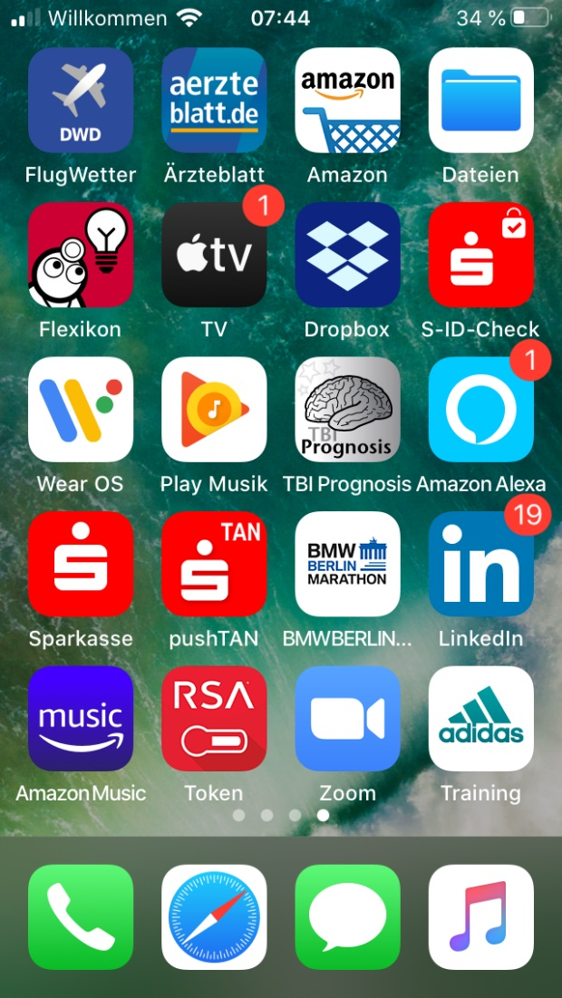
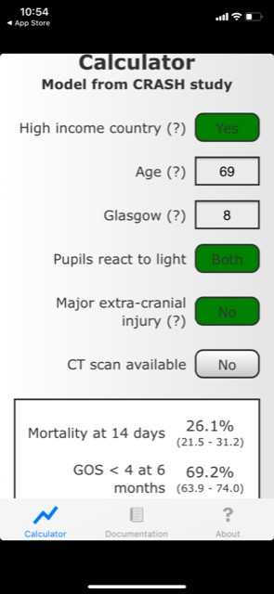
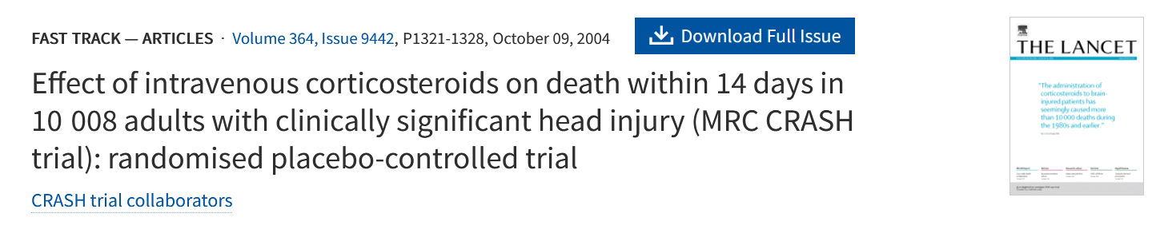
TBI Prognosis Calculator (from CRASH-TBI data)

Slide 5
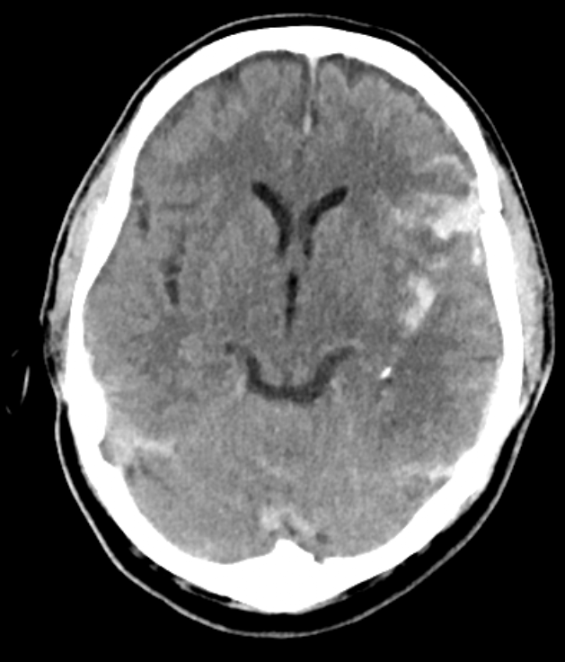
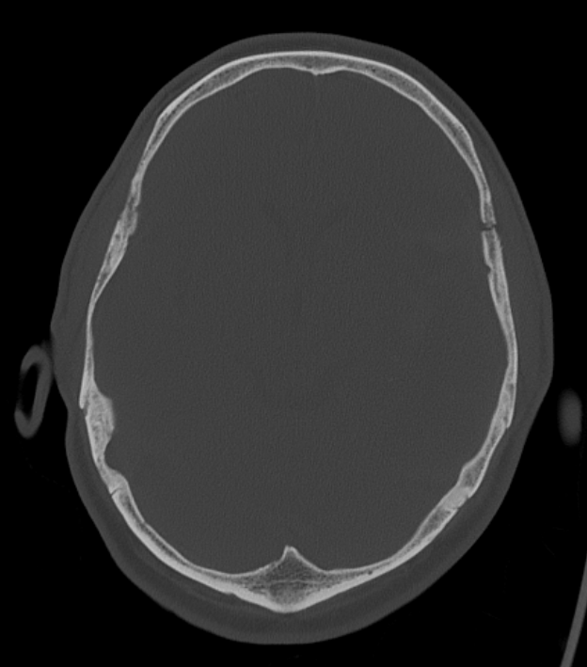
Illustrative Case - severe TBI
Clinical Presentation:
69 years, male
Fall from ladder
No anticoagulants
GCS 8
Intubation in the field
CT
Left frontotemporal/sphenoid fracture
Hematoma in the Sylvian Fissure
No other injuries

Slide 6
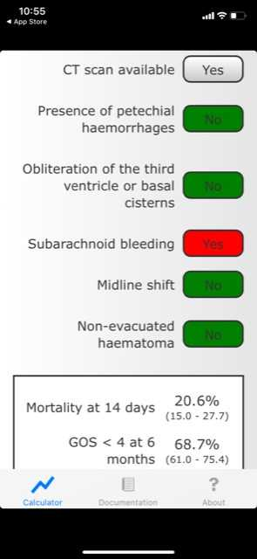
TBI Prognosis Calculator (from CRASH-TBI data)

Slide 7
Illustrative Case – elevated ICP
Hyperventilation
Hypothermia
Relaxants
Craniectomy
Barbiturate-Therapy
Osmotherapy
CSF-Drainage
Sedation
Positioning
T. Westermaier - Schädel-Hirn-Trauma

Slide 8
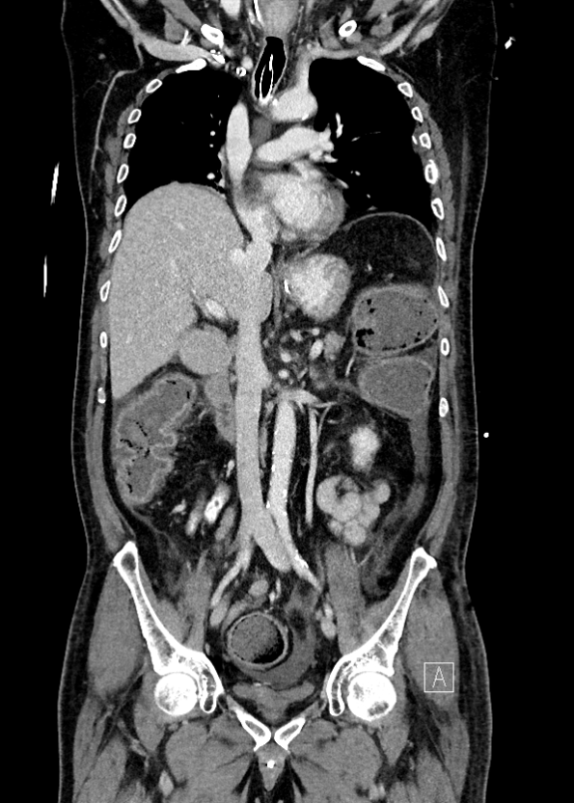
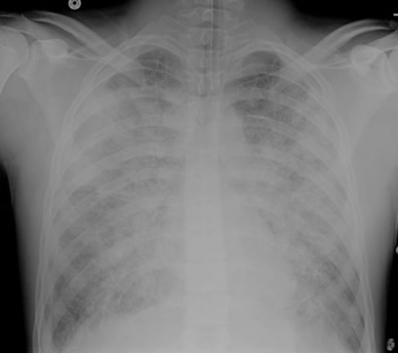
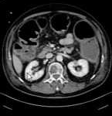
Illustrative Case – Complications
Colitis
Sepsis
Pneumonia
Cava-Thrombosis
AKI
Cardiac Arrythmias

Slide 9
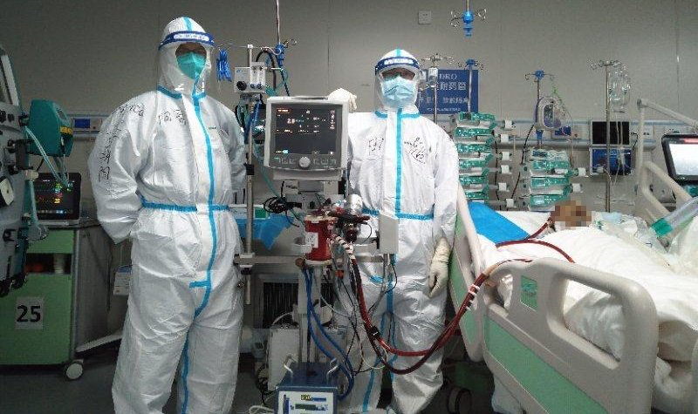
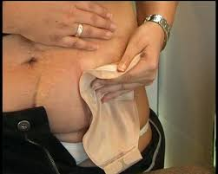
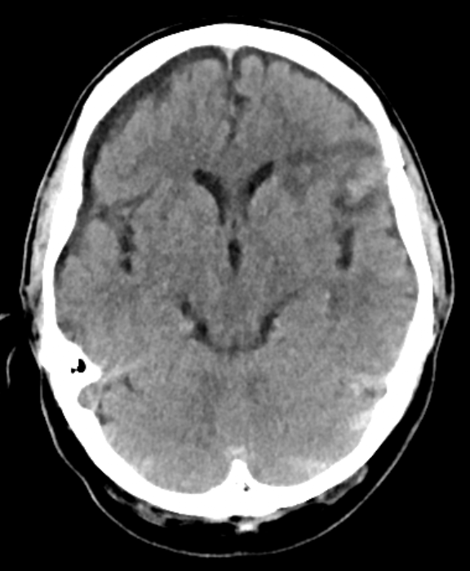
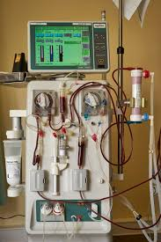
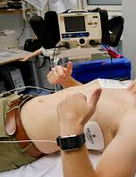
Life-Sustaining Therapy

Slide 10
Illustrative Case – Course of Therapy
Day 9

Slide 11
Illustrative Case – Course of Therapy
Day 9

Slide 12
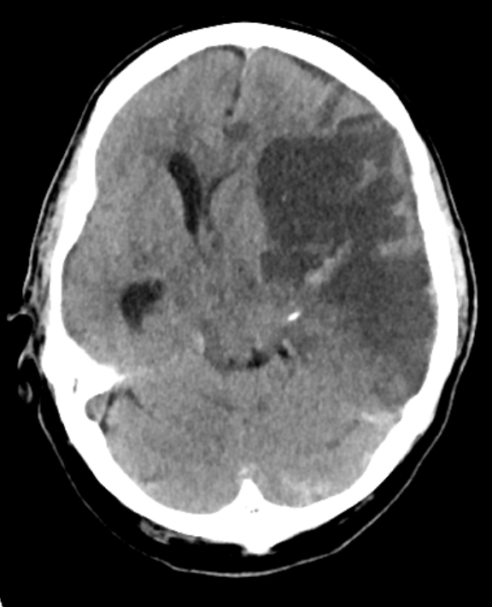
Illustrative Case – Course of Therapy
Day 12
LST withdrawn

Slide 13
Neuroprognostication
Are there any solid and reliable prognosticators for mortality or functional outcome in severe TBI
at the time of presentation or
during the course of therapy?

Slide 14
Neuroprognostication
Why?
Resource allocation (beds on ICU)
Expensive therapy (for poor outcome)
Personal burden for patient
Burden for Relatives
vs.
limiting treatment for patients with
potentially good outcome

Slide 15
Transatlantic and interdisciplinary collaboration/project
Authors (19 + 1 Statistics Consultant) and one patient or family representative for each disease
Katja Wartenberg, MD (Co-Chair), Neurology, University Hospital Leipzig, Germany
Susanne Muehlschlegel, MD, MPH, (Co-Chair), Univ. of Massachusets/Johns Hopkins University School of Medicine, USA
Sheila Alexander, PhD, RN, U of Pittsburgh, USA
Claire Creutzfeldt, MD, Neurology, U of Washington, USA
Katharina Busl, MD, Neurology, U of Florida, USA
Sara Hocker, MD, Neurology, Mayo Clinic, USA
David Hwang, MD, Neurology, U of North Carolina, USA
Keri Kim, PharmD, U of Illinois, USA
Dominik Madžar, MD, Neurology, U. Erlangen
Dea Mahanes, MSN, CCRN, Neurocritical, U of Virginia, USA
Shradda Mainali, MD, Neurology, Virginia Commonwealth Univ, USA
Jürgen Meixensberger, MD, PhD, Neurosurgery, U of Leipzig
Felipe Montellano, MD, Neurol, Epidemiology, U of Würzburg
Venkatakrishna Rajajee, MD, Neurology, U of Michigan
Oliver Sakowitz, MD, PhD, Neurosurgery, Ludwigsburg
Panos Varelas, MD, PhD, Neurology, Albany Medical College
Christian Weimar, MD, PhD, Neurology, BDH-Klinik Elzach
Thomas Westermaier, MD, PhD, Neurosurgery, Klinikum Dachau
Gabriel Fontaine, PharmD, Intermountain Healthcare
Hester Lingsma, PhD (Statistics Consultant), Erasmus MC

Slide 16
Project covers the 8 most common diseases in NCC
Cardiac Arrest
Guillain-Barré Syndrome
Intracerebral Hemorrhage
Acute Ischemic Stroke
Subarachnoid Hemorrhage
Traumatic Spinal Cord Injury
Status Epilepticus
Moderate-Severe TBI

Slide 17
GRADE methodology for Guidelines -
- Neuroprognostication Guideline Projectt

Slide 18
GRADE methodology – PICOTS Question
PICOTS Question:
P opulation
I ntervention=Predictor
C omparator N/A
Outcome
T ime frame
S etting
“When counseling family members and/ or surrogates of patients with <disease>, should <predictor or prediction model, with time of assessment if appropriate> be considered a reliable predictor of <outcome> ?”

Slide 19
GRADE methodology – PICOTS Question
PICOTS Question:
P opulation
I ntervention=Predictor
C omparator N/A
Outcome
T ime frame
S etting
“When counseling family members and/ or surrogates of patients with moderate/severe TBI, should <predictor or prediction model, with time of assessment if appropriate> be considered a reliable predictor of <outcome> ?”

Slide 20
GRADE Methodology – Ranking of Outcomes by perceived importance
(2 experts + family representative)
8-9
Mortality (in-patient and beyond)
Functional outcome (6-months and beyond)
7.7-8
Quality of life
Cognitive outcome
<7
Depression
Return to work
We report
on these
outcomes
Most important
and chosen
Important outcomes
but no
qualifying
studies
Did not meet
threshold of
important

Slide 21
GRADE methodology – PICOTS Question
PICOTS Question:
P opulation
I ntervention=Predictor
C omparator N/A
Outcome
T ime frame
S etting
“When counseling family members and/ or surrogates of patients with moderate/severe TBI, should <predictor or prediction model> be considered a reliable predictor of mortality and/or functional outcome after 6 months and beyond?”

Slide 22
Step 1: Librarian search April 2019, authors
updated lit search prior to finalizing recommendations
Step 2: Content expert review of articles
Step 3: Expert selection of candidate predictors and models
GRADE methodology - Systematic Review
“What are reliable predictors/models prior to or on admission to ICU and during hospital course to predict outcome of x disease”
Level 1: 2 authors per disease -abstract level screening
(disease; age ≥16y; human studies)
Level 2: Full-text screening
excl: n<100/50/35, no MV analysis, not adjusted for pre-determined major baseline confounders, several others
Full-text article review
Selection of candidate predictors/models
by 2-4 experts:
clinically relevant
accessible to clinicians
likely to be considered by clinicians
Supplementation of addtl. articles
between 4/2019 and publication

Slide 23
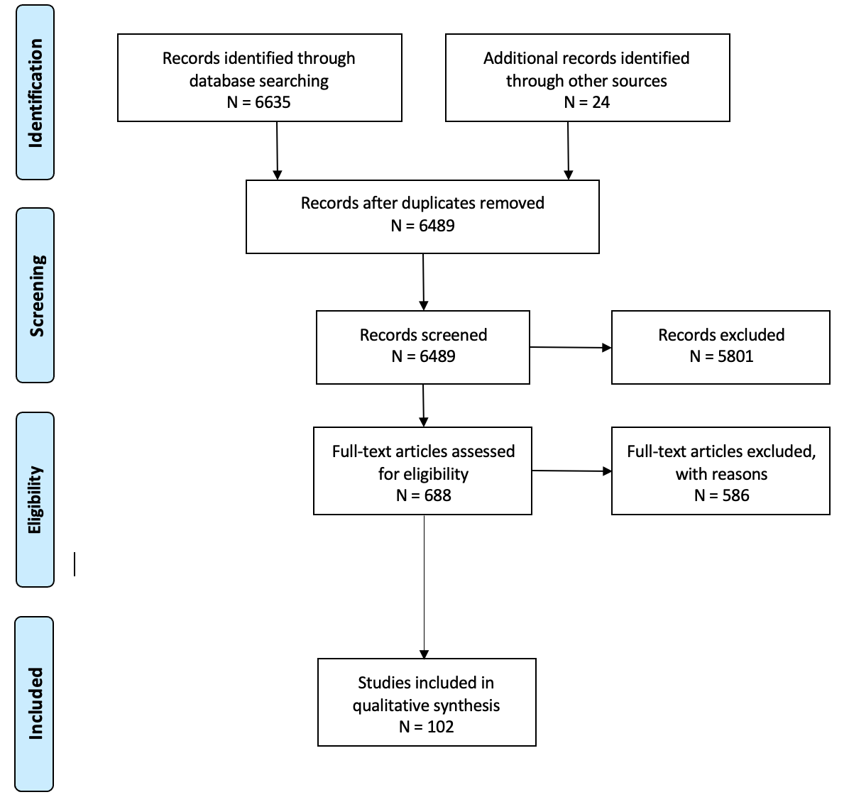
Grade/Systematic Review - PRISMA Flow Diagram
Neuroprognostication in patients with
moderate-severe TBI
Important exclusion criteria:
n<100
no MV analysis
MV analysis did not include age and (m)GCS
Intervention studies
age <16
Biomarkers and Models:
no external validation in at least 1 add. study
Models without discrimination

Slide 24


GRADE - Tools for data extraction and risk of bias assessment
QUIPS
for individual predictors
PROBAST
for prediction models
Quality in Prognosis Studies
Prediction model Risk Of Bias
Assessment Tool

Slide 25
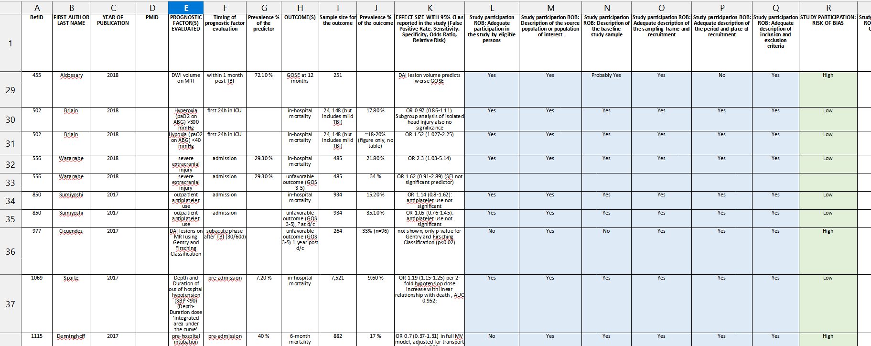
GRADE - Tools for data extraction and ROB assessment - QIPS
Quality in Prognosis Studies
Prediction model Risk Of Bias
Assessment Tool

Slide 26
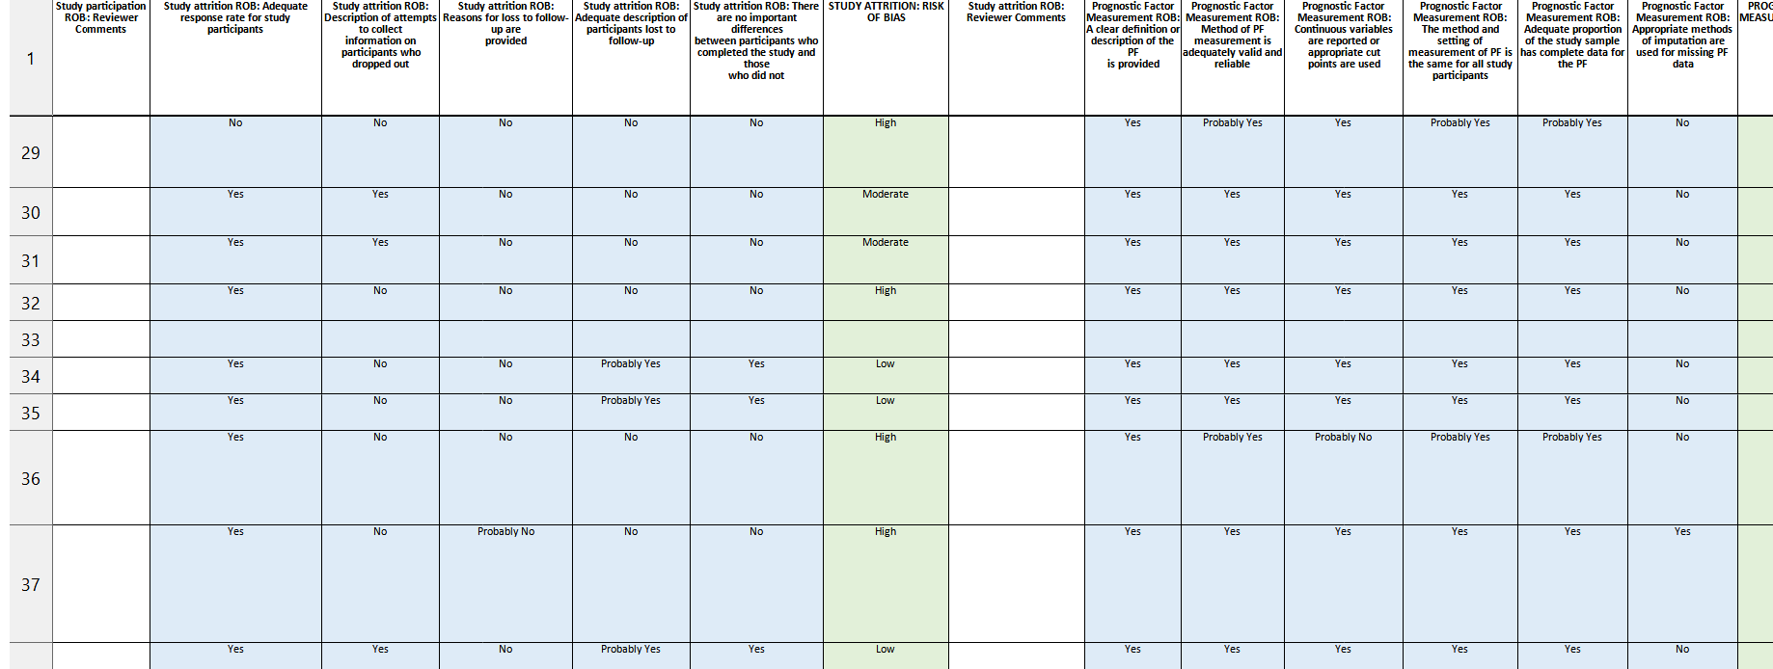
GRADE - Tools for data extraction and ROB assessment - QIPS
Quality in Prognosis Studies
Prediction model Risk Of Bias
Assessment Tool

Slide 27
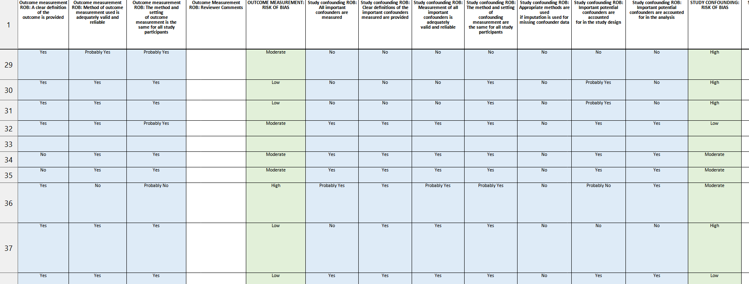
GRADE - Tools for data extraction and ROB assessment - QIPS
Quality in Prognosis Studies
Prediction model Risk Of Bias
Assessment Tool

Slide 28
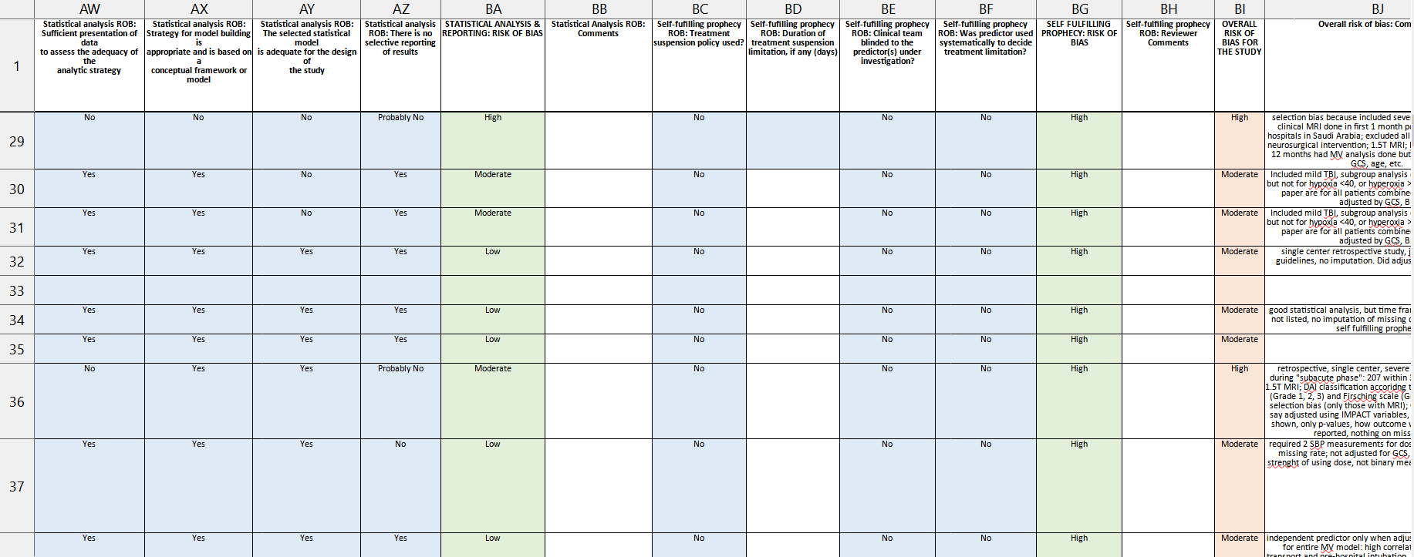
GRADE - Tools for data extraction and ROB assessment - QIPS
Quality in Prognosis Studies
Prediction model Risk Of Bias
Assessment Tool

Slide 29
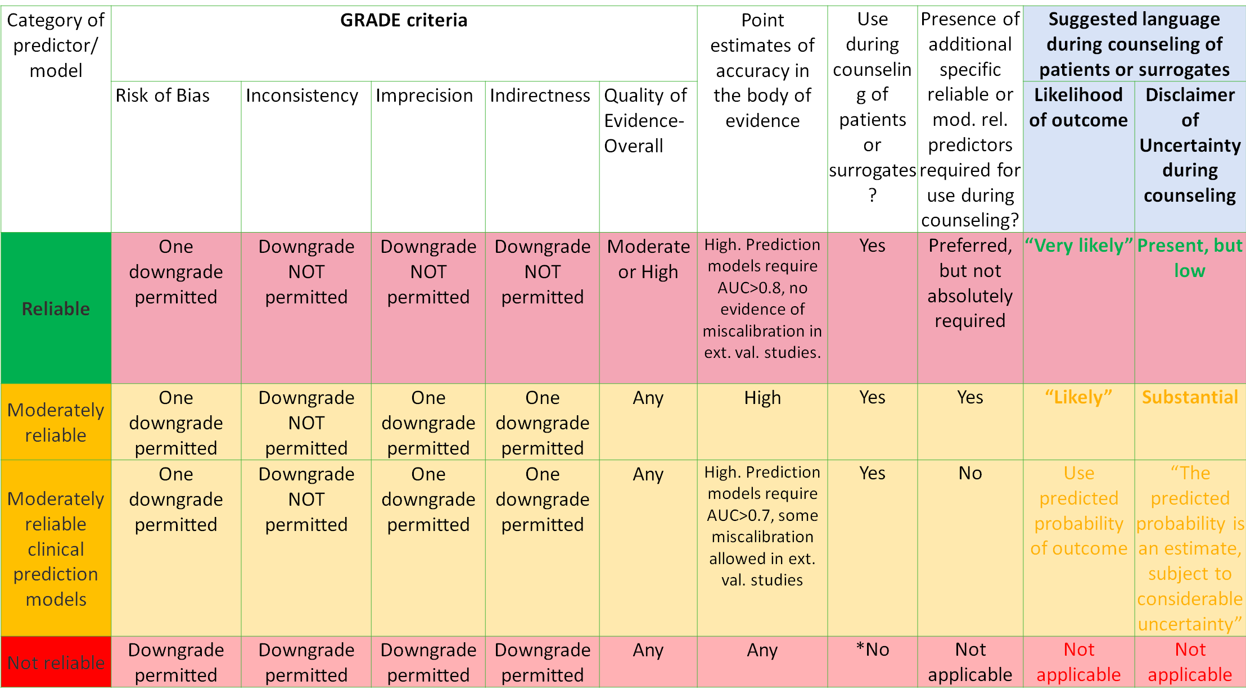
Grade - Reliable/moderately reliable predictors

Slide 30
Our Recommendations are based on
1. Balance between desirable and undesirable outcomes
2. Overall quality of evidence for outcomes
3. Confidence in values and preferences and their variability
4. Resource use

Slide 31
Results of our Systematic Review

Slide 32
Based on our criteria, we identified the following individual prognosticators:
Mortality beyond discharge
Age
Pupillary Reactivity
GCS or mGCS
Hypotension (SBP <90 mmHg pre or at admission)
Hypoxia (oxygen saturation <90% or paO2 <110mmHg before or after admission)
Intracranial Hypertension
Additional major extracranial Injury
Acute Kidney Injury (AKI) during ICU Treatment
ETOH intoxication
Hypernatremia during ICU treatment
Functional Outcome 6 months and beyond
Age
Pupillary Reactivity
GCS or mGCS
Hypotension (SBP <90 mmHg pre or at admission)
Hypoxia (oxygen saturation <90% or paO2 <110mmHg before or after admission)
Intracranial Hypertension
Post-traumatic cerebral infarction
Acute Kidney Injury (AKI) during ICU Treatment

Slide 33
Based on our criteria, we identified the following Prediction Models:
CRASH-basic and CRASH-CT
Marshall-CT
Rotterdam-CT
Helsinki-CT
Stockholm-CT
IMPACT-core, IMPACT-extended & IMPACT-lab

Slide 34
General Principles of Neuroprognostication in msTBI
(Good Practice Statements)
Prognostication should be performed with consideration of the complete clinical condition and not be based on a single variable.

Slide 35
General Principles of Neuroprognostication in msTBI
(Good Practice Statements)
Prognostication should be performed with consideration of the complete clinical condition and not be based on a single variable.
Prognostication should not be performed based only on ultra-early injury characteristics. We suggest a minimum of 3-5 days of full critical care support, and if possible, at least 2-3 weeks of full critical care or medical support before attempting prognostication.

Slide 36
General Principles of Neuroprognostication in msTBI
(Good Practice Statements)
Prognostication should be performed with consideration of the complete clinical condition and not be based on a single variable.
Prognostication should not be performed based only on ultra-early injury characteristics. We suggest a minimum of 3-5 days of full critical care support, and if possible, at least 2-3 weeks of full critical care or medical support before attempting prognostication.
Prognostication should be performed carefully without nihilism or bias and should only be performed with consideration of all available evidence and not based on personal anecdotal experience alone.

Slide 37
Individual Predictors
PICOTS question:
When counseling family members and/ or surrogates of patients with
moderate-severe TBI, should <individual predictor> be considered a
reliable predictor of <outcome> ?”

Slide 38
 |  | Outcomes
 |  | Mortality at discharge and beyond
Clinical Variables | Age | not reliable
 | Bilateral pupillary non-reactivity | moderately reliable
 | Unilateral pupillary non-reactivity | not reliable
 | GCS/motor GCS | not reliable
 | Hypotension in field/ED | not reliable
 | Hypoxia in field/ED | not reliable
 | Intracranial hypertension (ICP>20mmHg) | not reliable
 | Major extracranial injury | not reliable
 | Acute kidney injury | not reliable
 | positive alcohol test on admission | not reliable
 | Hypernatremia during ICU course | not reliable
 | post-traumatic cerebral infarction | no data
Mortality
(At discharge and beyond)

Slide 39
 |  | Outcomes
 |  | Mortality at discharge and beyond | Functional Outcome at 6 months and beyond
Clinical Variables | Age | not reliable | not reliable
 | Bilateral pupillary non-reactivity | moderately reliable | moderately reliable
 | Unilateral pupillary non-reactivity | not reliable | not reliable
 | GCS/motor GCS | not reliable | not reliable
 | Hypotension in field/ED | not reliable | not reliable
 | Hypoxia in field/ED | not reliable | not reliable
 | Intracranial hypertension (ICP>20mmHg) | not reliable | not reliable
 | Major extracranial injury | not reliable | no data
 | Acute kidney injury | not reliable | not reliable
 | positive alcohol test on admission | not reliable | no data
 | Hypernatremia during ICU course | not reliable | no data
 | post-traumatic cerebral infarction | no data | not reliable
Functional Outcome
(At 6-months and beyond)

Slide 40
Prediction Models
PICOTS question:
When counseling family members and/ or surrogates of patients with
moderate-severe TBI, should <prediction model> be considered a
reliable predictor of <outcome> ?”
Notes:
<Foliennummer>

Slide 41
 |  | Outcomes
 |  | Mortality at discharge and beyond
Prediction Models | CRASH-basic; CRASH-CT | moderately reliable
 | IMPACT-core; IMPACT-extended | moderately reliable
 | IMPACT-lab | moderately reliable
 | Marshall CT | not reliable
 | Rotterdam CT | not reliable
 | Helsinki CT | not reliable
 | Stockholm CT | not reliable
Mortality
(At discharge and beyond)

Slide 42
 |  | Outcomes
 |  | Mortality at discharge and beyond | Functional Outcome at 6 months and beyond
Prediction Models | CRASH-basic; CRASH-CT | moderately reliable | moderately reliable
 | IMPACT-core; IMPACT-extended | moderately reliable | moderately reliable
 | IMPACT-lab | moderately reliable | moderately reliable
 | Marshall CT | not reliable | not reliable
 | Rotterdam CT | not reliable | not reliable
 | Helsinki CT | not reliable | not reliable
 | Stockholm CT | not reliable | not reliable
Functional Outcome
(At 6-months and beyond)

Slide 43
Conclusion
No individual predictor reliable enough to base a limitation of treatment on it ALONE (bilaterally unreactive pupils)
Clinical prediction models useful as a part of decision making but not for initial decision to limit treatment (IMPACT, CRASH)
No parameter “on the run”
    intracranial hypertension – imprecise, threshold not consistently defined
    acute kidney injury – inconsistent, may be transient without effect on outcome
    Hypernatremia – imprecise, threshold or linear? May be transient
    Secondary ischemia/infarction – inconsistent, depends on location and extent
Disappointing!
    Large body of literature with limited quality
    Only few high-quality publications
    Evaluation by the GRADE system is very (too?) strict an rigid

Slide 44




Our manuscript has been published:
https://www.ncbi.nlm.nih.gov/pmc/articles/PMC10959796/
We welcome comments via Email:
SMuehlsch@jhu.edu
thomas.westermaier@helios-gesundheit.de
Thank you!
We would like to acknowledge and thank our TBI family representative Mrs. Darlene LeTavec.

Slide 45

Thank you for the attention

Slide 46


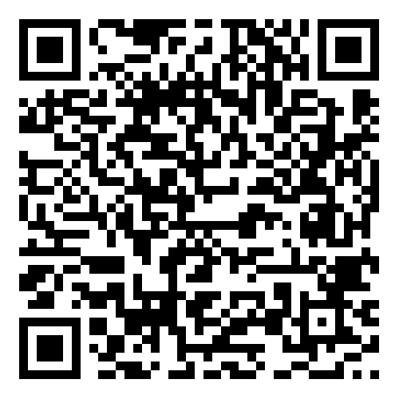

The German Annual NeuroIntensive Care Meeting – ANIM
becomes more international in 2027
and two tracks with scientific symposia
in English will be offered.
Join us in Berlin as our speaker, chair, or guest!
For details, scan the code:
German English

Slide 47
Disclosures and Acknowledgment
We have no conflicts of interest.
Prof. Dr. Susanne Muehlschlegel has received research funding from the National Institutes of Health (R21NR020231, U01NS119647 and U01NS099046) and honoraria from the American Academy of Neurology as a speaker.
Prof. Dr. Westermaier has received research funding from the Else-Kroener-Fresenius-Stiftung, consulting fees and honoraria from Medtronic Navigation.
We would like to acknowledge and thank our TBI family representative Mrs. Darlene LeTavec.

